Slide 1
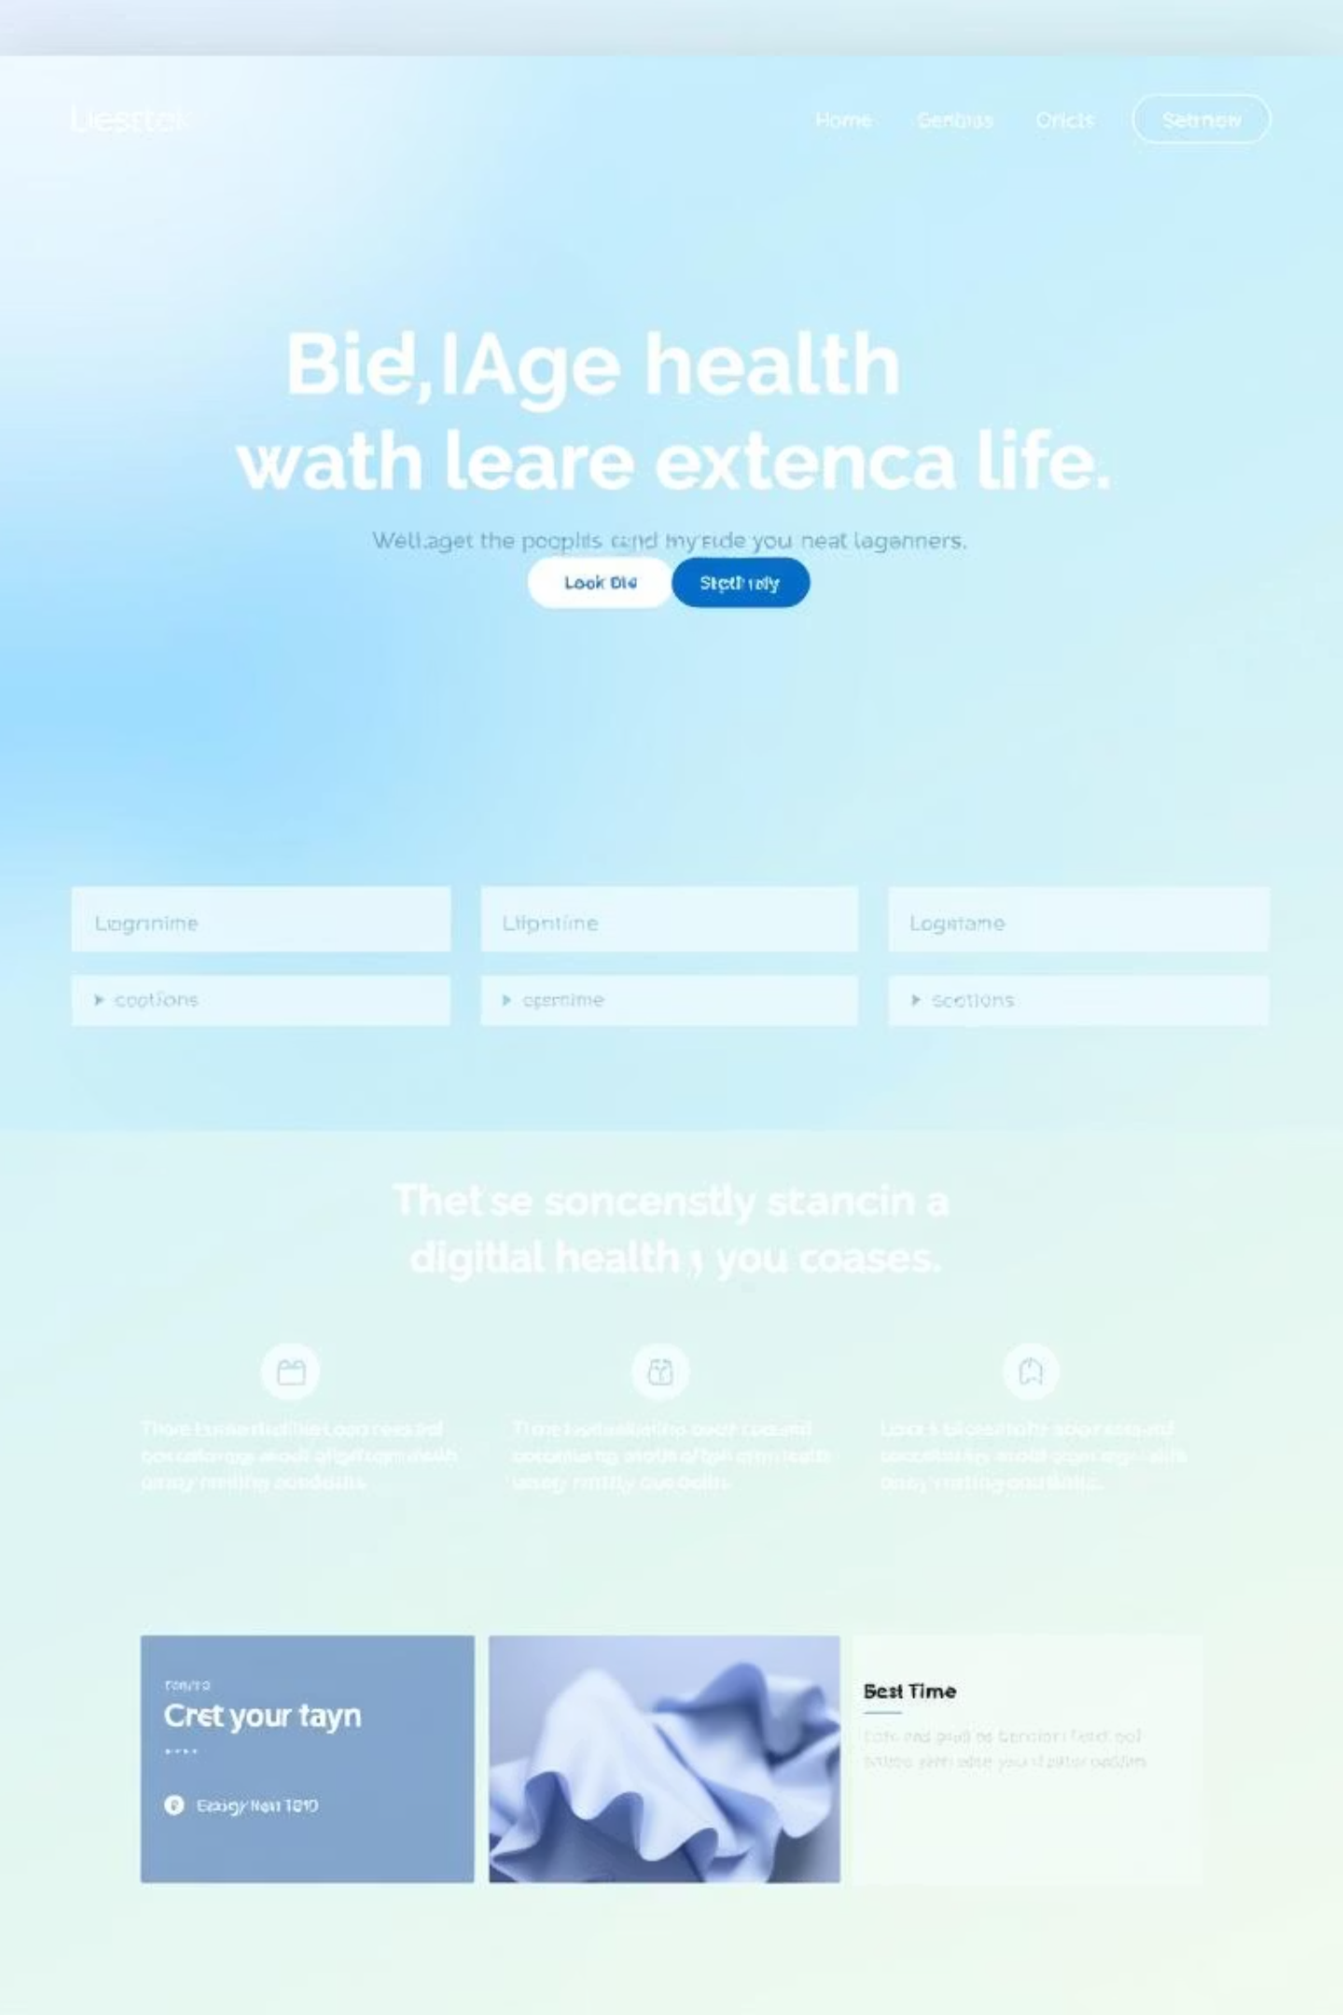
HealthBooker: Revolutionizing Patient Booking & Health Management
Presented by:
Jamshaid Ahmad - BSSE23015
Muhammad Sher - BSSE23023
Instructors:
Sir Zunnurain
Sir Umair

Slide 2

Executive Summary: Empowering Healthcare with HealthBooker
Integrated Portals
Cloud-Native
Architecture
HealthBooker offers comprehensive patient and provider portals for streamlined online booking and centralized health record management.
Built on AWS, our solution is cloud-native, ensuring high security, exceptional scalability, and robust performance.
Transformative Outcome
The system aims to significantly reduce administrative time, boost patient engagement, and enhance the quality of clinical decision-making.

Slide 3




The Current Healthcare Landscape: Problems HealthBooker Solves
High Administrative Burden
Fragmented Patient
Data
Suboptimal Patient Experience
Legacy System Challenges
Healthcare facilities are often overwhelmed by manual scheduling, paper-based record keeping, and repetitive administrative tasks, leading to inefficiencies and staff burnout.
Patient information is frequently scattered across disparate systems and physical files, making it challenging for providers to access a complete and accurate health history.
Without online booking options and easy access to personal health records, patients often face inconvenience, delays, and a lack of transparency in their healthcare journey.
Many existing systems suffer from scalability limitations and reliability issues, struggling to meet the demands of growing patient populations and modern healthcare needs.

Slide 4


Project Objectives: Crafting a Seamless Healthcare Future
Optimize Workflow
To significantly reduce front-desk workload, minimize administrative overhead, and decrease patient no-show rates through automated scheduling and reminders.
Enhance Patient Access
To empower patients with convenient online booking capabilities and secure access to their personal health records anytime, anywhere.
Centralize Clinical Data
To provide healthcare providers with a unified, comprehensive view of patient data, facilitating better-informed clinical decisions and care coordination.
Ensure Robust Infrastructure
To deploy a highly secure, scalable, and continuously available cloud-based solution that meets industry standards for reliability and data protection.

Slide 5
HealthBooker: Key Features for Modern Healthcare
1
2
Intuitive Patient Portal
Comprehensive Provider Portal
Effortless online appointment booking and rescheduling.
Centralized appointment management and scheduling tools.
Automated appointment reminders via SMS and email.
Detailed patient timelines with visit history and notes.
Secure access to personal medical history and lab results.
Efficient entry and management of clinical notes.
3
4
Robust Security & Auditing
Smart Notifications & Analytics
Granular role-based access control for data integrity.
Configurable notification system for various events.
Detailed audit logging for all system interactions.
Basic dashboards offering insights into appointments and patient data trends.
Traceability features ensuring accountability and compliance.
Tools for operational efficiency monitoring.

Slide 6
HealthBooker Architecture: A Robust Cloud Foundation
PROBLEM
OBJECTIVE
Our backend utilizes a resilient REST API with Auto Scaling EC2 instances behind an Application Load Balancer for high availability. Data is stored in Amazon DynamoDB, providing a serverless, low-latency database solution. User identity and roles are securely managed via Amazon Cognito.

Slide 7
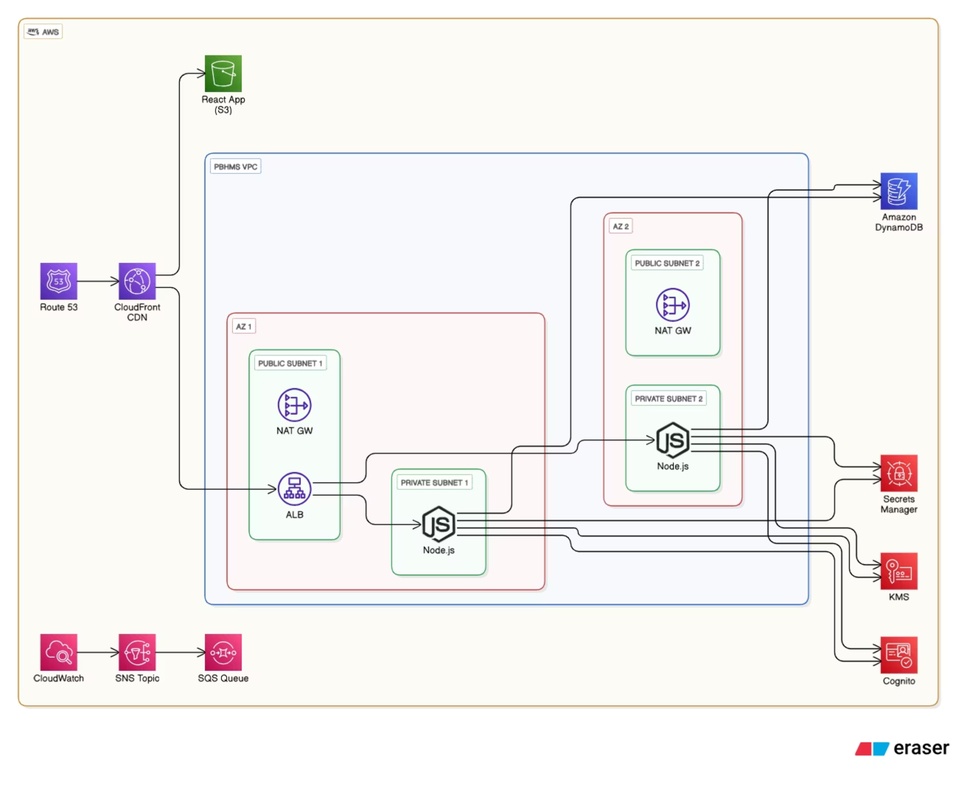

Slide 8
Implementation Summary: Bringing HealthBooker to Life
01
02
Frontend Development
Backend & API
Developed using React, creating a responsive single-page application (SPA) for both the Patient and Provider Portals, ensuring a consistent user experience across devices.
A robust Node.js/Express API serves as the backend, deployed to AWS EC2 instances managed by Auto Scaling Groups for dynamic load handling and high availability.
03
04
Database Management
Authentication & Security
Leveraged Amazon DynamoDB, a NoSQL database, with a carefully designed partition key strategy to ensure efficient retrieval and storage of patient records, optimizing performance and scalability.
Implemented Amazon Cognito for secure user authentication and authorization. Role-based access control (RBAC) and secure JSON Web Token (JWT) flows protect sensitive data and restrict access based on user roles.

Slide 9

Security & Resilience: Safeguarding Healthcare Data
Robust Authentication & RBAC
Authentication and Role-Based Access Control (RBAC) are meticulously managed through Amazon Cognito, ensuring only authorized personnel access relevant data.
Encrypted Communication
All data in transit is secured using HTTPS, with TLS termination handled by the Application Load Balancer (ALB), protecting against eavesdropping and tampering.
Scalability & Durability
Auto Scaling Groups dynamically adjust resources to handle peak loads, while Amazon DynamoDB ensures data durability and high availability through its distributed architecture.
Comprehensive Disaster Recovery
A robust disaster recovery plan is in place, including Point-in-Time Recovery and cross-region replication for DynamoDB, guaranteeing data integrity and business continuity.

Slide 10
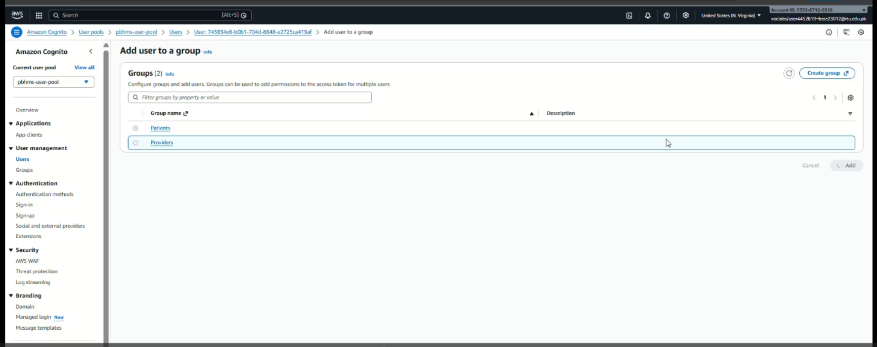

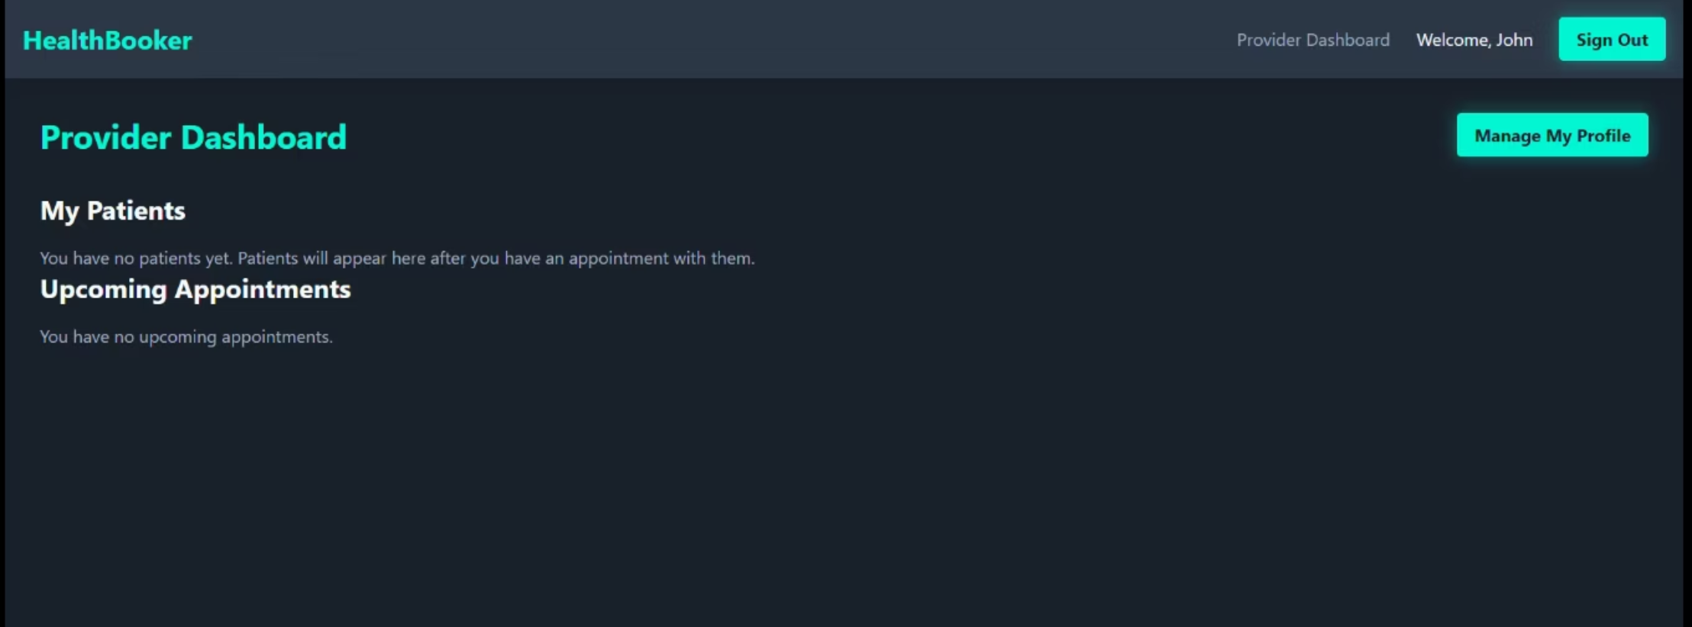

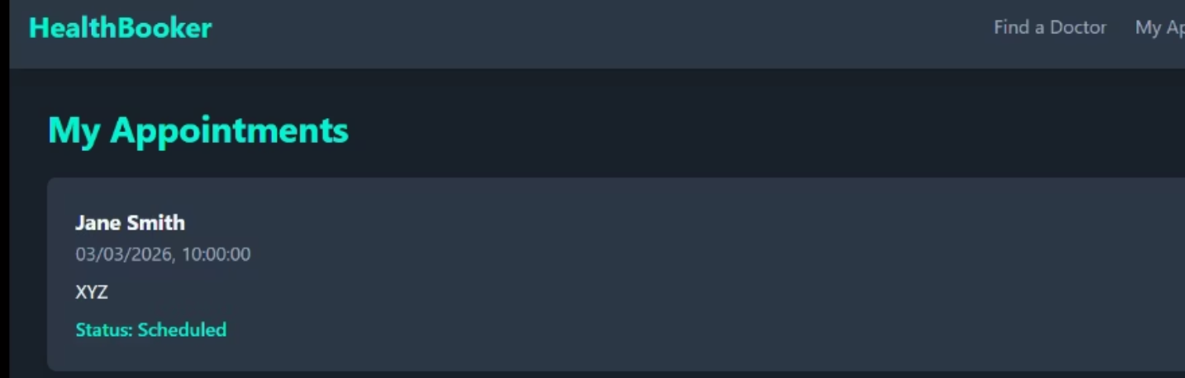
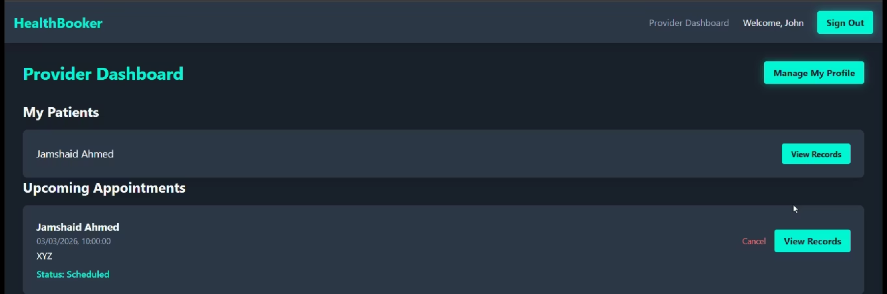
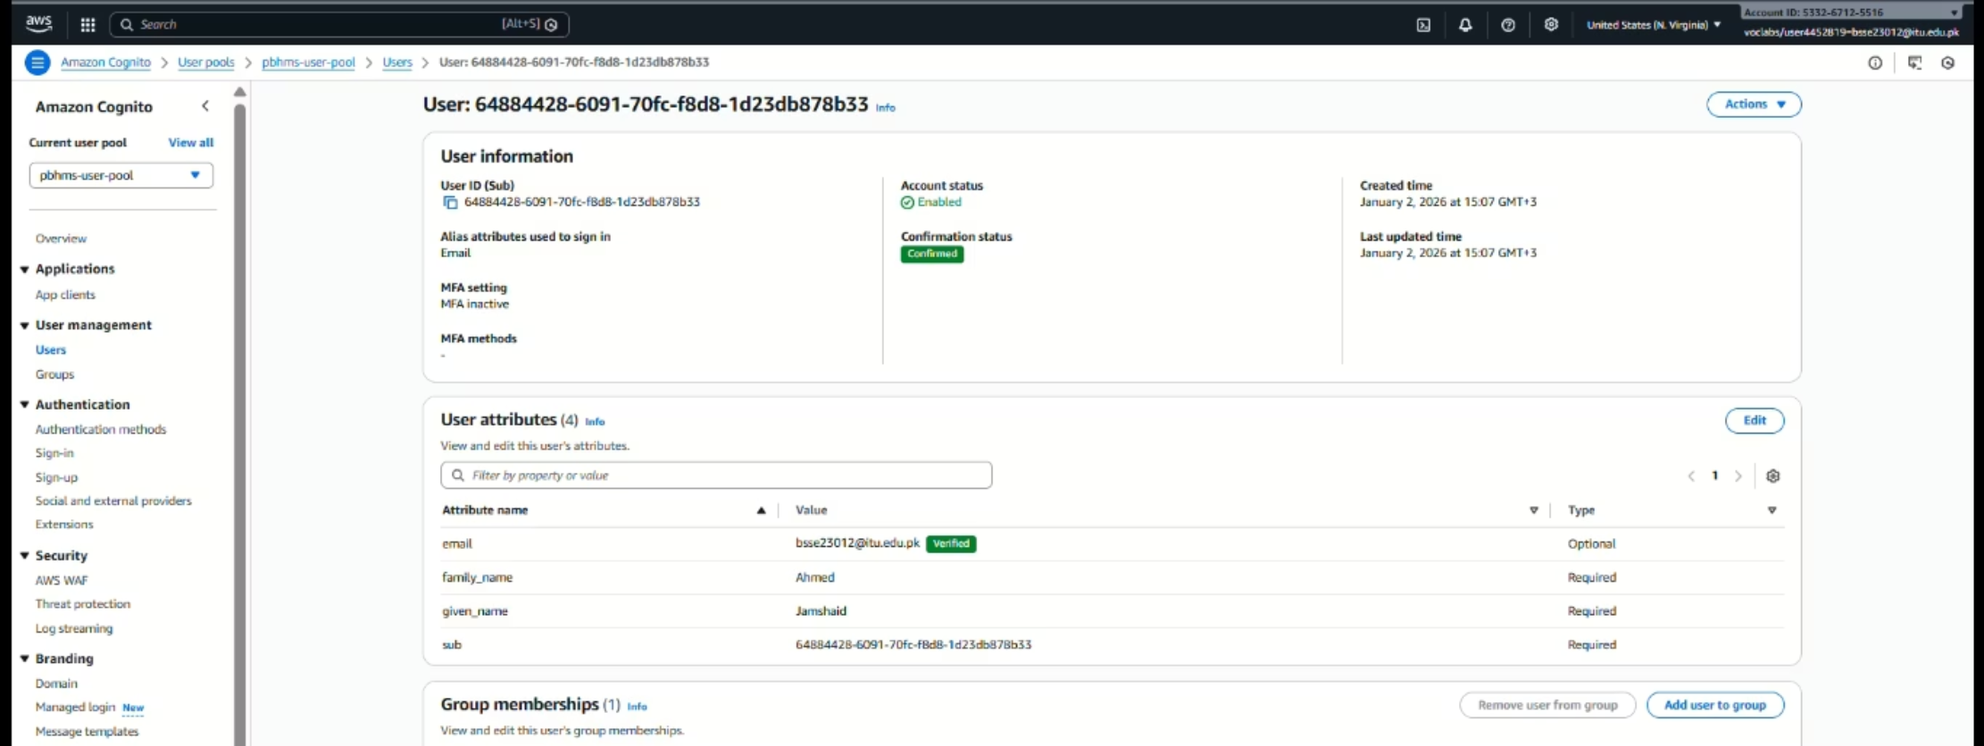
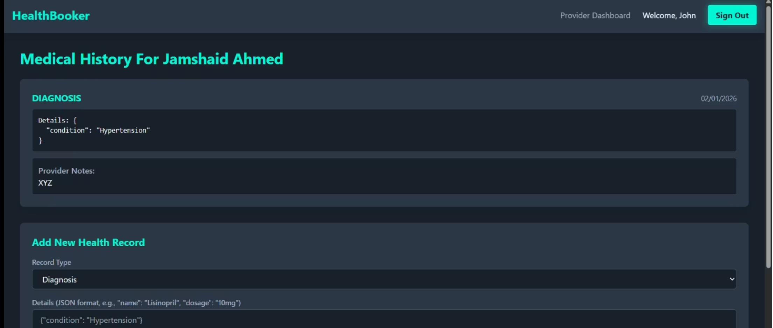
4
DEMO / SCREENSHOTS
1
5
2
6
7
3
8

Slide 11

Conclusion: Pioneering Efficient and Patient-Centric Healthcare
HealthBooker stands as a testament to modern healthcare innovation, effectively addressing critical challenges through a cloud-native approach. By significantly reducing administrative overhead and centralizing patient data, we are not just building a system; we are enhancing the quality of care and optimizing clinic operations using cloud best practices.
This project demonstrates a robust and scalable solution poised to transform how clinics manage patient interactions and health records, setting a new standard for efficiency and patient satisfaction.

